Slide 1

Prediction Of Life Quality

Slide 2
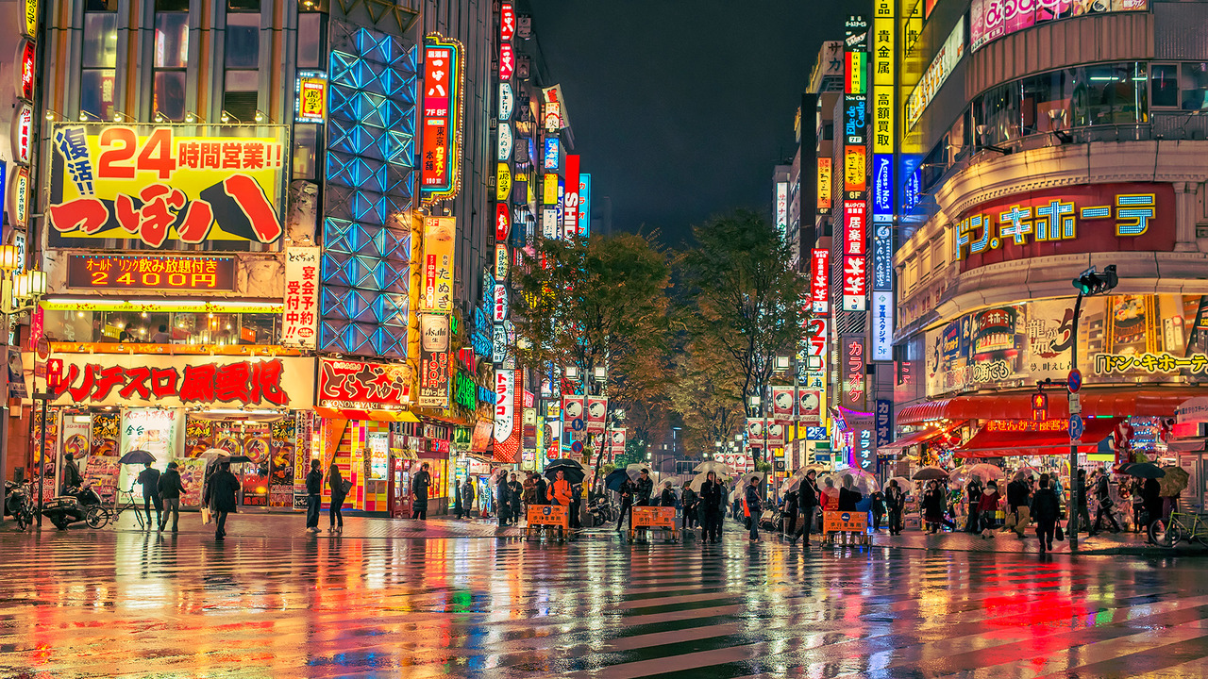
MOTIVATION
Münih
Nairobi
Determine the effects of social and physical characteristics on human life
Make cities more livable
Change the imbalance positively.

Slide 3
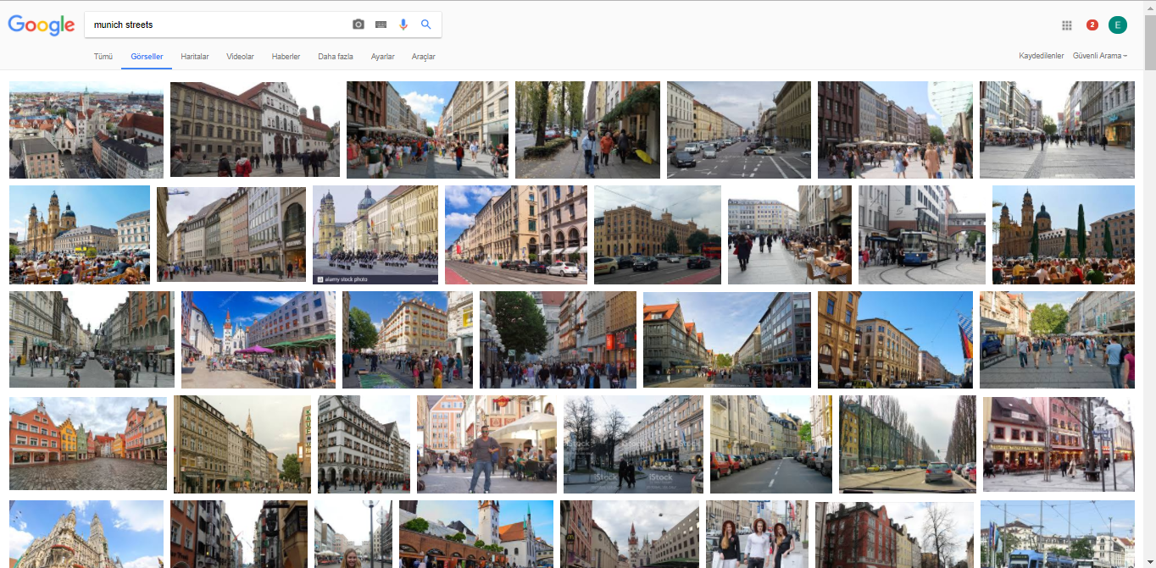

Slide 4
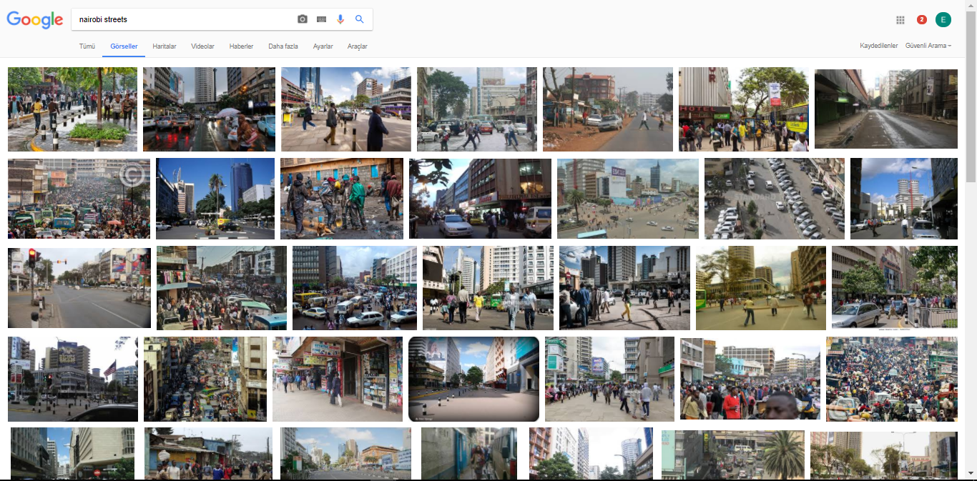

Slide 5

QUALITY OF LIFE
“Quality of life (QOL) is the general well-being of individuals and societies, outlining negative and positive features of life. It observes life satisfaction, including everything from physical health, family, education, employment, wealth, religious beliefs, finance and the environment”.^{[1]}

Slide 6
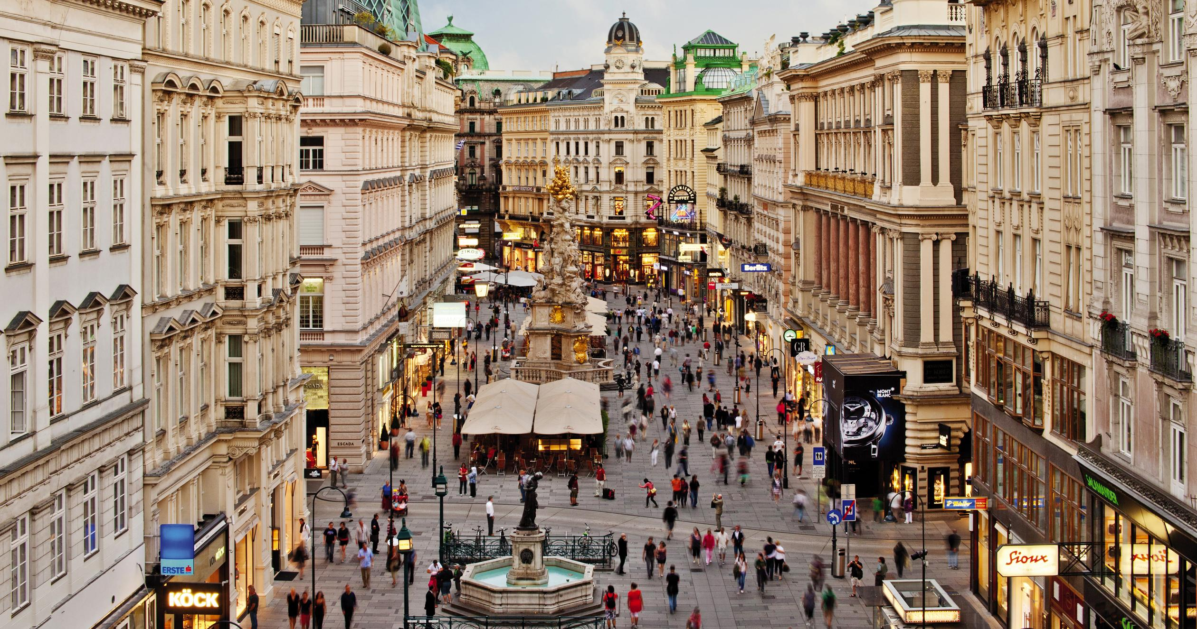
PURPOSES
Higher efficiency
Shorter time
Reduced burden on human
New, flexible and developable method

Slide 7
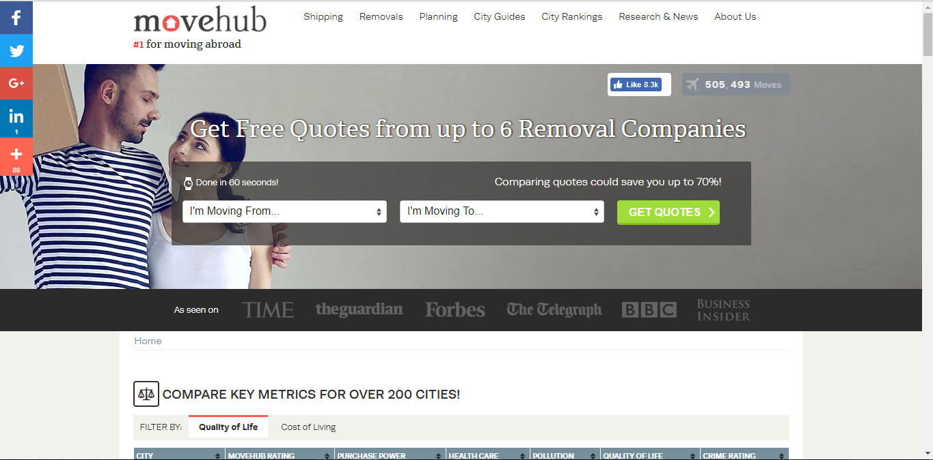
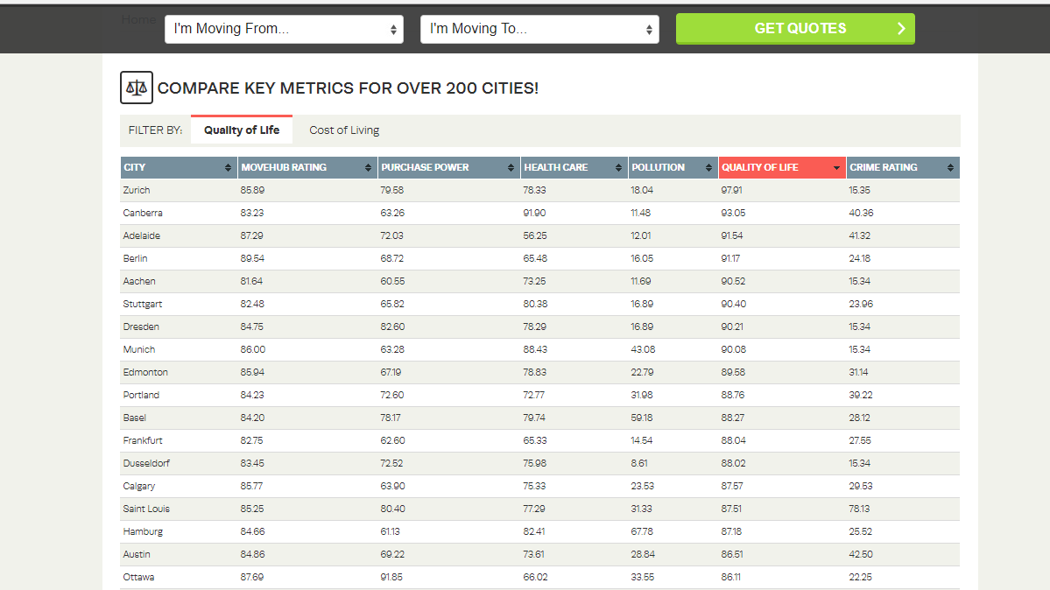
MOVEHUB
Compare key metrices for over 200 cites.
Rank List:
Quality of Life
Cost of Living

Slide 8
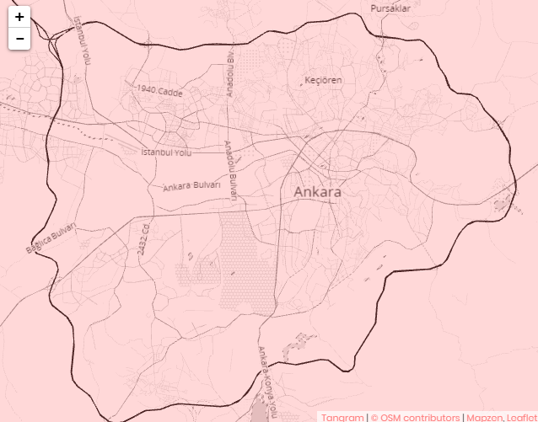
DATASET
MAPILLARY
GOOGLE EARTH PHOTOS
GOOLE MAPS TAGS
MAPZEN

Slide 9
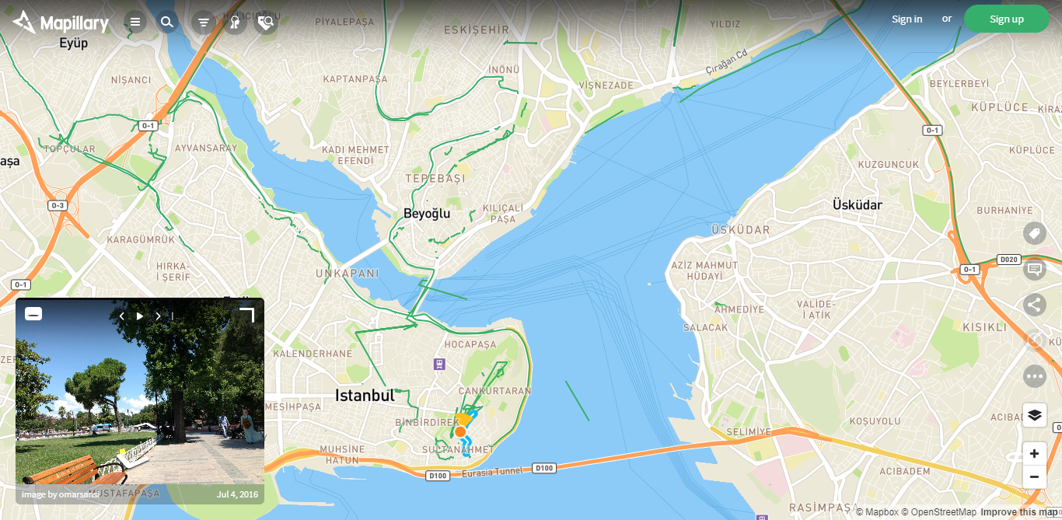
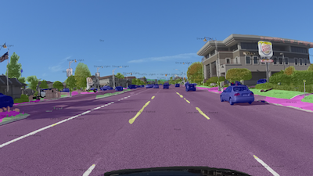
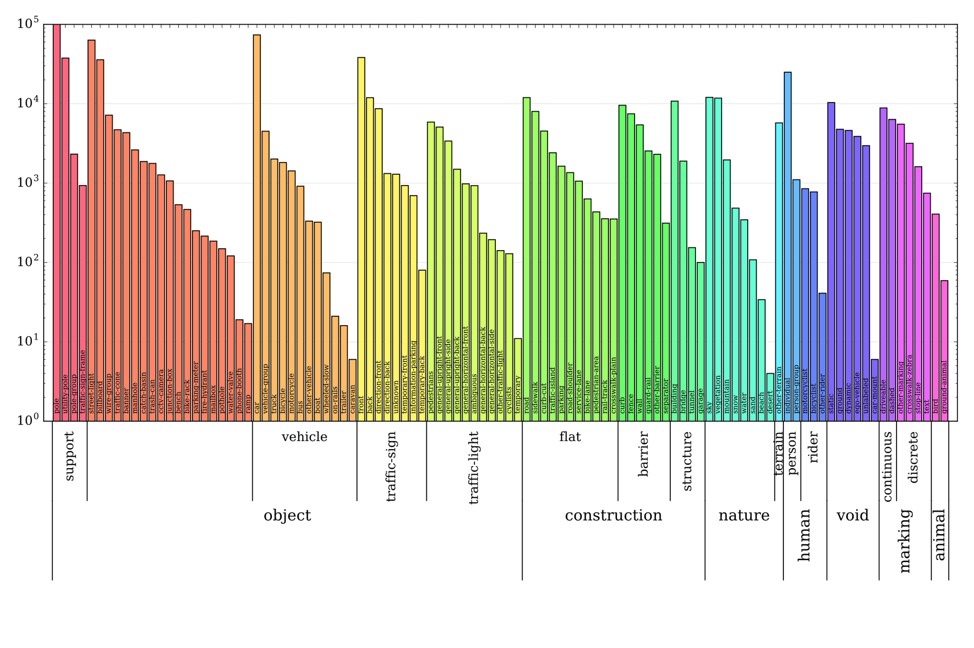
MAPILLARY
25,000 high-resolution images (split into 18,000 for training, 2,000 for validation, 5,000 for testing; at an average resolution of ~9 megapixels) with pixel-wise annotations from >2 million manually drawn polygons
100 object categories, 60 of those instance-specific (i.e. to enumerate objects)
Global geographic reach, covering North and South America, Europe, Africa, Asia, and Oceania
High variability in weather conditions (sun, rain, snow, fog, haze) and capturing times (dawn, daylight, dusk, and even night)
Broad range of camera sensors, varying focal length, image aspect ratios, and different types of camera noise
Different capturing viewpoints (from road, sidewalks, and off-road)

Slide 10
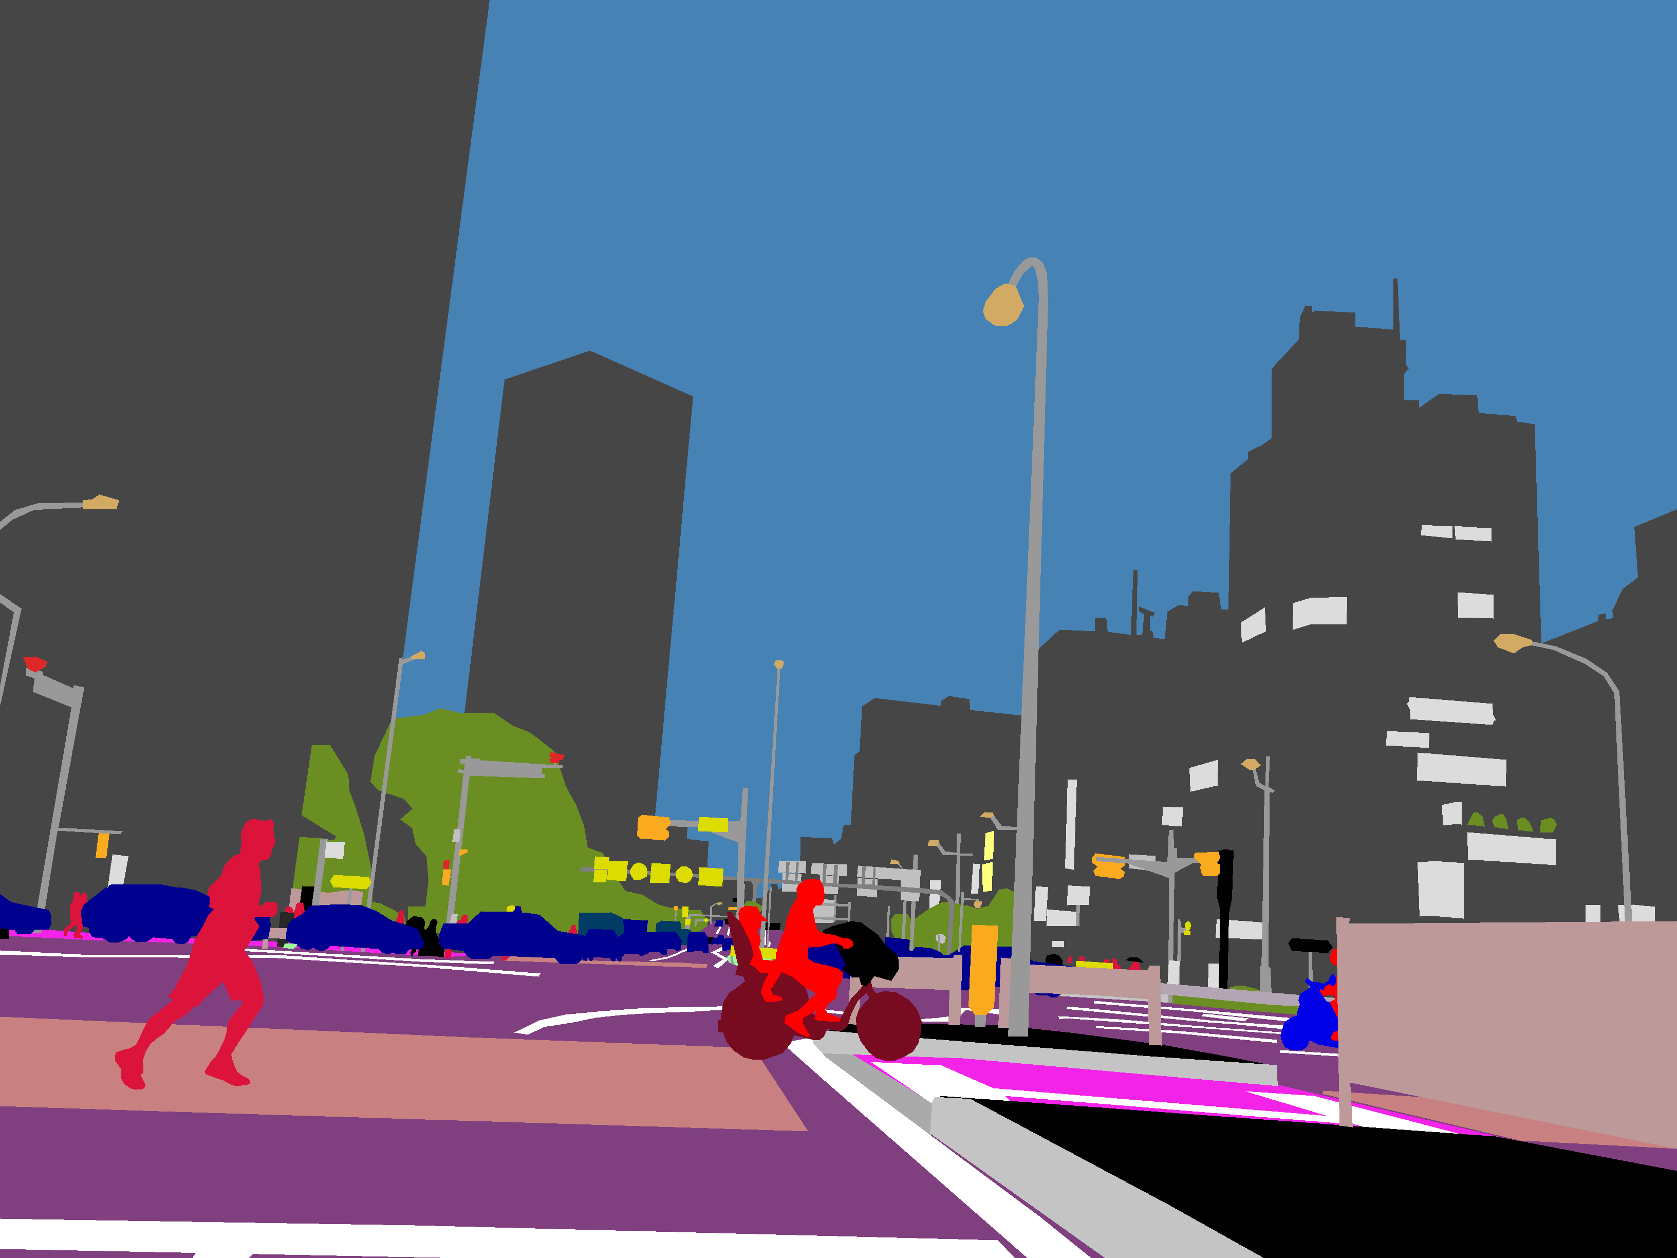
MAPILLARY
We requested permission for download
It took one week for the reply.
Data was not categorized city by city.

Slide 11
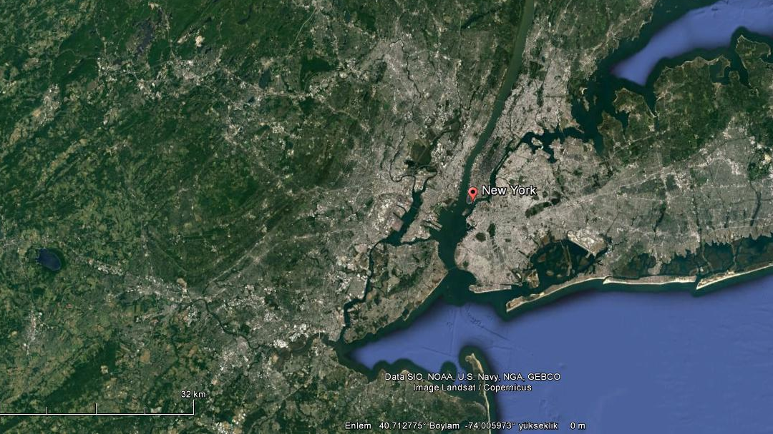
Google Earth Satellite Photos & Maps
Satellite photos were downloaded manually with google earth pro
Maps were downloaded with high resolution to detect google tags like metro,park,hospital
To accomplish this we used template matching.

Slide 12
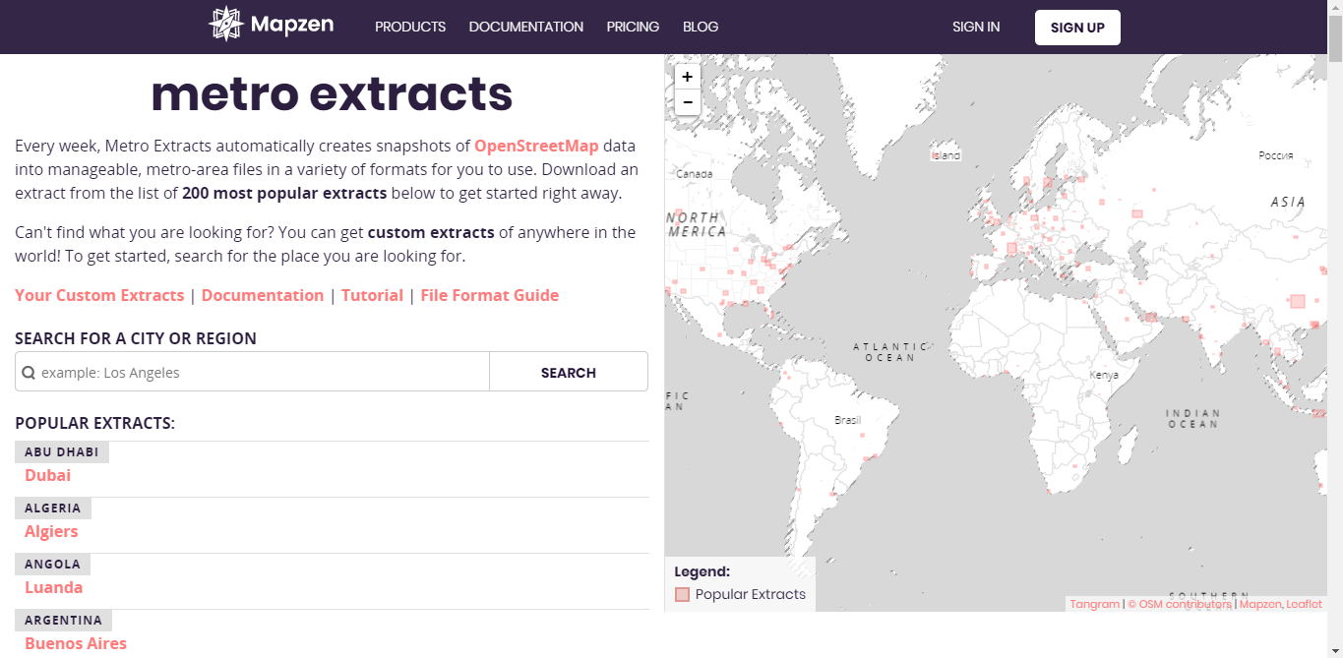
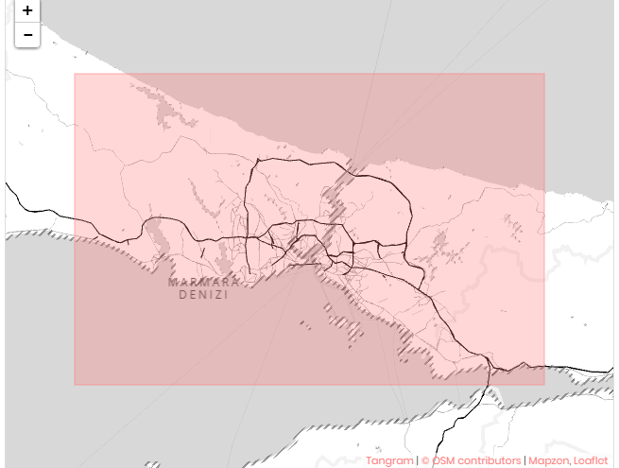
MAPZEN
Then we found Mapzen datas.
Mapzen includes geojson files for the whole world.
Two hundred most known cities were ready for download.
114 cities were match with the cities that are in movehub list

Slide 13
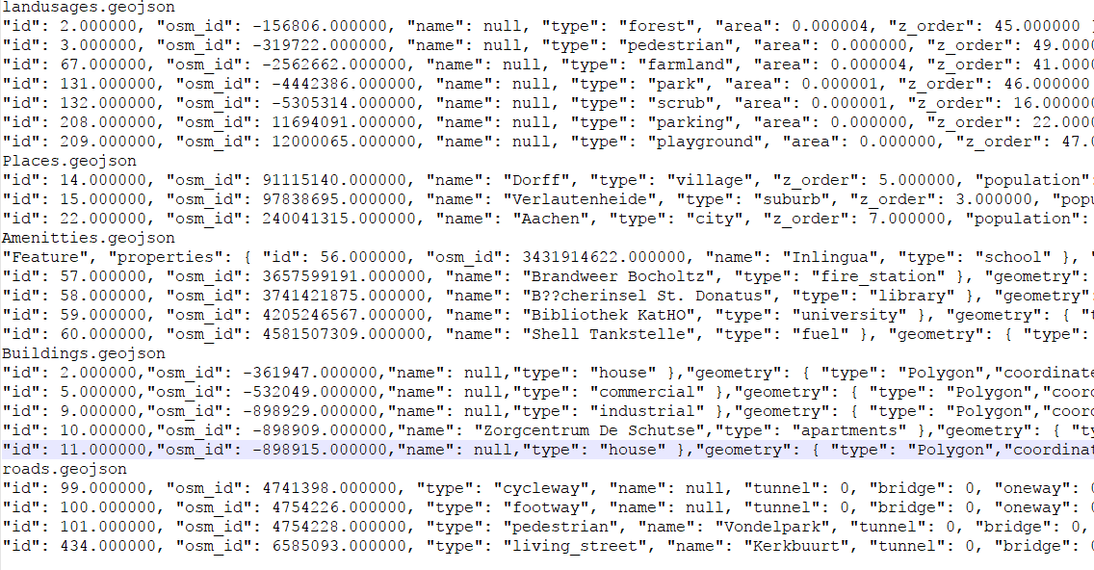
What is in the geojson files

Slide 14
Feature Selection
There are hundreds of metrics in geojson files
We used 85 of them
These are
School,hospital,park.. number per people
Ratio of land usages(forest,commercial,residential,farmyard…)
Ratio of population in village,city
Road lengths(cycleway,pedestrian,living Street..)
Number of transportation points(metro,bus stop,station..)

Slide 15
Data Extraction
We downloaded 20GB of zipped data
Extracted size is 50gb
We created a train, validation and test data set from this data.
150 cities in train
50 cities in validation
16 cities for test
Our data set is less than 1 MB

Slide 16

MODELLING
Using scikit-learn
Support Vector Machine Regression (also SVR)
Linear Kernel
Polynomial Kernel
Sigmoid Kernel
RBF Kernel
Decision Tree Regression (also Regression Tree)

Slide 17
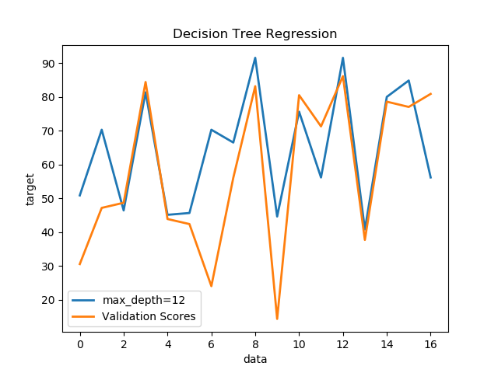

Slide 18
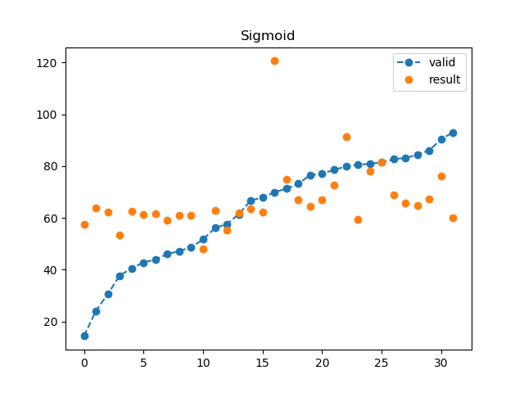
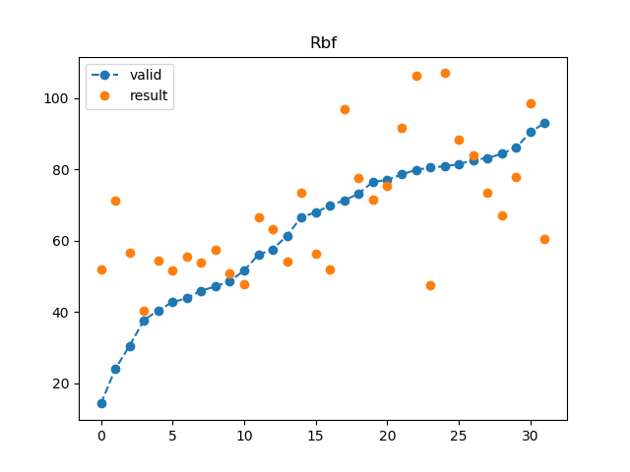

Slide 19
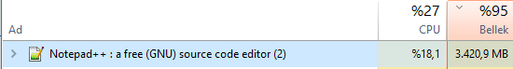
STRENGTHS AND WEAKNESSES
Data Extraction
Huge file sizes
Data collection(Time Consuming)
Encode of files
We have areas of lands
Populations ratios
We can get data for any city

Slide 20

RELATED WORKS
Researches
NUMBEO
MOVEHUB
EUROSTAT
MERCER
Predicting Sentiment about Places of Living by Feifei Liu 2017
Movehub rating prediction by Jonathan bouchet on kaggle

Slide 21
Future Work
Coordinates can be used effectively
Can be transform into classification problem
Can be used Ranking algorithms

